Slide 1
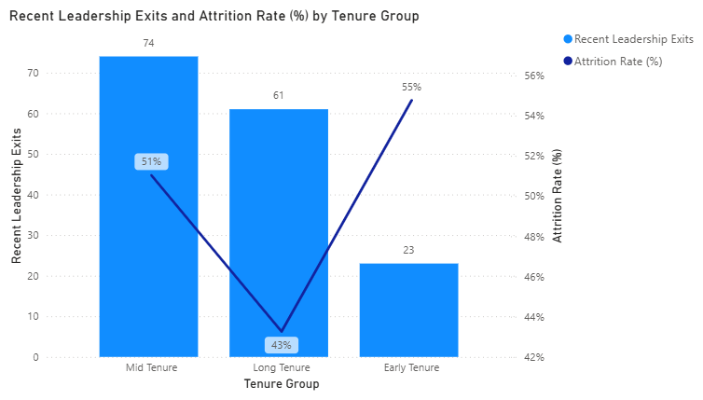
Highest attrition risk appears early, but exit volume peaks in mid-tenure
1/10
ANALYST INTERPRETATION
This visual shows two different risk signals that matter for the leadership population. Early-tenure leaders have the highest attrition rate at 59%, which suggests the first stage of leadership integration is the most fragile. However, the largest number of recent exits sits in the mid-tenure group with 74 exits, meaning the organization is also losing experienced leaders after they have already built organizational knowledge. Long-tenure leaders show a lower attrition rate at 43%, indicating better retention once leaders remain embedded for longer periods. This insight matters because one retention strategy will not address both patterns. Pulse Diagnostics should strengthen onboarding and early-career leadership support, while also reviewing advancement, recognition, and mobility opportunities for mid-tenure leaders where total exit volume is greatest.
Source visuals: Power BI screenshots

Slide 2
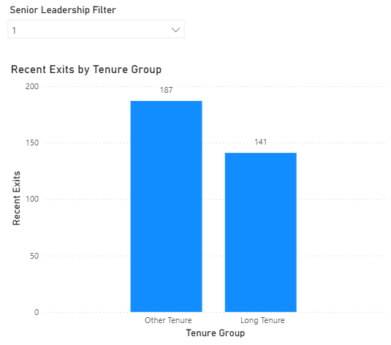
Exits are more concentrated outside the long-tenure leadership group
2/10
ANALYST INTERPRETATION
When the tenure groups are simplified into long tenure versus all other tenure stages, exits are higher outside the long-tenure group, at 187 compared with 141. This indicates leadership attrition is not primarily concentrated among deeply tenured employees. Instead, a larger share of exits occurs before leaders reach long-tenure status, which is consistent with the first chart’s signal that earlier career stages are less stable. The business importance is significant. Long-tenure losses still create capability gaps, but the wider leakage across other tenure groups weakens the leadership pipeline before it fully matures. For the organization, this points to a succession and career-path issue, not just a late-career retention issue. Interventions should focus on keeping leaders through the middle of their leadership journey rather than assuming experience alone will solve retention.
Source visuals: Power BI screenshots

Slide 3
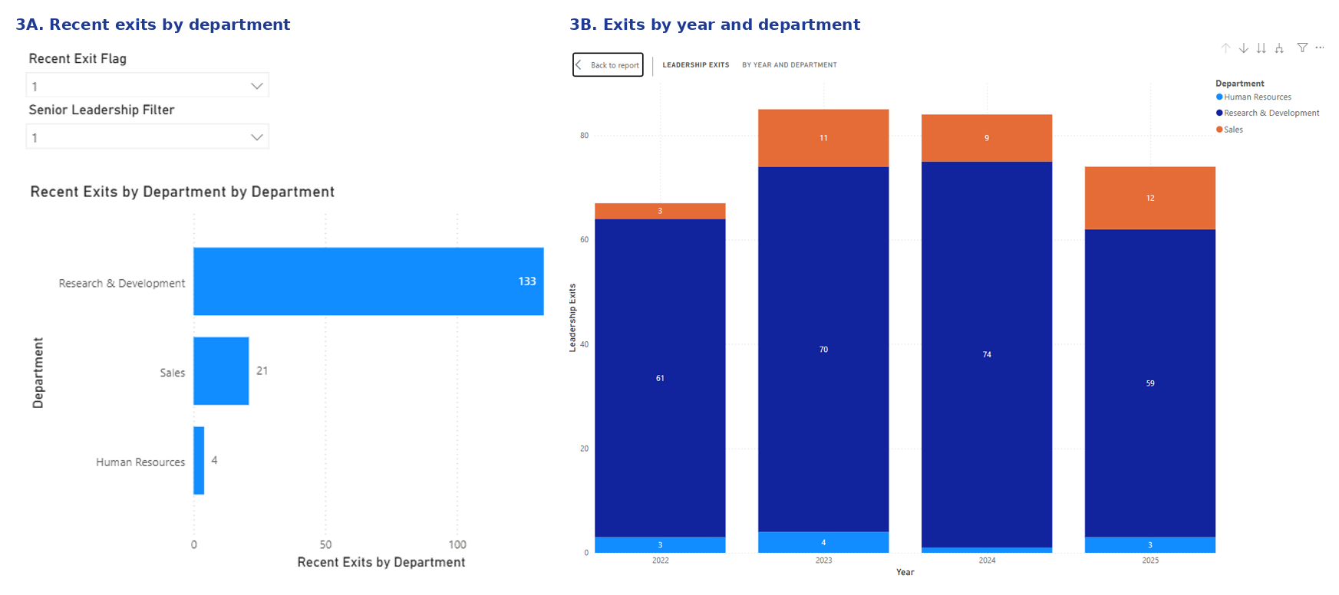
Department risk is concentrated and persistent in Research and Development
3/10
ANALYST INTERPRETATION
This combined department view shows both scale and persistence of exits. The first panel identifies Research and Development as the clear concentration point with 133 recent exits, far above Sales at 21 and Human Resources at 4. The second panel shows that this is not a one-year anomaly: Research and Development contributes the largest exit volume in every year displayed, while Sales remains a secondary but visible source of loss. Together, these visuals suggest attrition is structurally concentrated in specific parts of the business rather than evenly distributed across leadership roles. This matters because leadership turnover in Research and Development can disrupt product continuity, innovation delivery, and technical team stability. The organization should prioritize root-cause investigation in Research and Development first, while also monitoring Sales for targeted retention action where department-specific pressures may differ.
Source visuals: Power BI screenshots

Slide 4
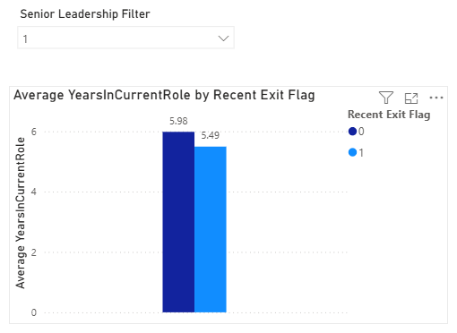
Years in current role does not meaningfully separate recent exits from others
4/10
ANALYST INTERPRETATION
Average years in current role is nearly identical for the two groups: 5.56 years for non-recent or active leaders and 5.49 years for recent exits. That narrow difference indicates time in role, by itself, is not meaningfully separating leaders who stayed from leaders who left. In other words, recent attrition does not appear to be driven simply by leaders becoming stagnant after a fixed period in position. This is an important finding because time in role is often treated as a proxy for career frustration. Here, the measure does not provide strong support for that assumption. For Pulse Diagnostics, this means retention actions should not rely on tenure triggers alone. A more useful next step is to examine promotion timing, lateral mobility, and external hiring demand to understand whether career opportunity, rather than time served, is shaping exits.
Source visuals: Power BI screenshots

Slide 5
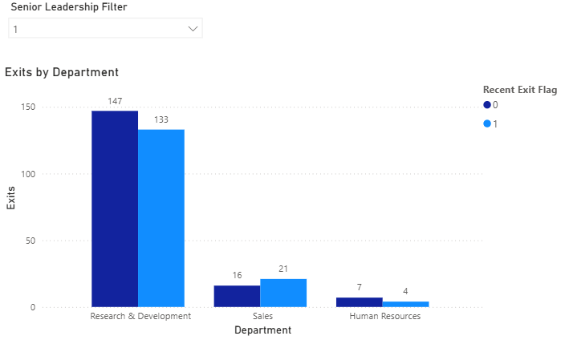
Research and Development is a chronic hotspot, while Sales shows newer risk
5/10
ANALYST INTERPRETATION
This department comparison adds timing context to the earlier department story. Research and Development shows high exit levels in both groups, with 147 in the comparison group versus 133 recent exits, confirming that turnover pressure has been consistently elevated. Sales tells a different story: recent exits at 21 exceed the comparison count of 16, which may signal a more current or emerging retention issue. Human Resources remains low in both periods. The insight is important because it separates chronic risk from new risk. Research and Development appears to be a long-running structural hotspot requiring deeper root-cause work, while Sales may need a quicker intervention to prevent momentum from building. For the organization, this helps prioritize action by department instead of applying a generic leadership retention plan across the whole business.
Source visuals: Power BI screenshots

Slide 6
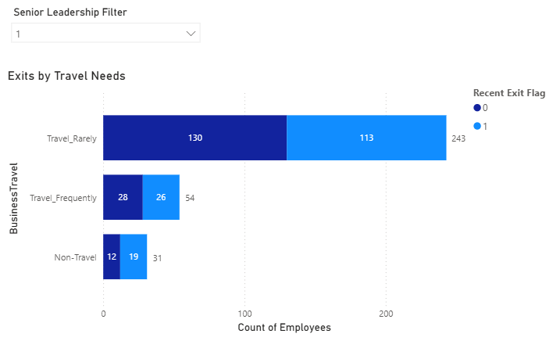
Travel requirements do not appear to be a major driver of leadership exits
6/10
ANALYST INTERPRETATION
Travel-related categories do not show a pattern strong enough to explain leadership attrition. Most exits sit in the Travel_Rarely group, but that is also likely the largest segment of the leadership population, while Travel_Frequently remains much smaller and does not display a disproportionate recent-exit signal. Non-travel roles also show only modest counts. The practical takeaway is that business travel, although often raised as a quality-of-life concern, does not appear to be a primary differentiator in this leadership dataset. This matters because organizations can easily overreact to visible workload factors that are not actually driving exits. For Pulse Diagnostics, broad travel-policy changes are unlikely to solve the leadership attrition issue on their own. Retention effort should stay focused on stronger explanations such as function-specific pressures and potential career mobility constraints.
Source visuals: Power BI screenshots

Slide 7
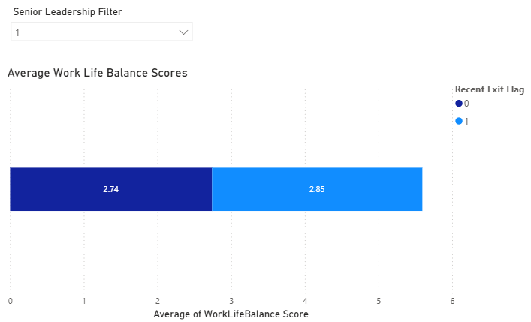
Work-life balance scores are almost the same for leavers and non-leavers
7/10
ANALYST INTERPRETATION
Average work-life balance scores are nearly the same across groups, with recent exits scoring slightly higher rather than lower. That pattern weakens the argument that leaders left primarily because of poorer day-to-day balance. If work-life balance were a major driver, the exiting group would typically show a visibly lower average. Instead, the difference is small and moves in the opposite direction. This is important because work-life balance is one of the most common assumptions made when leaders resign, yet this visual suggests it was not a distinguishing factor in this case. For the organization, the implication is to avoid defaulting to generic well-being solutions as the main response. Resources will be better spent on investigating career progression, internal movement opportunities, and role-specific demands in the departments with the heaviest exit patterns.
Source visuals: Power BI screenshots

Slide 8
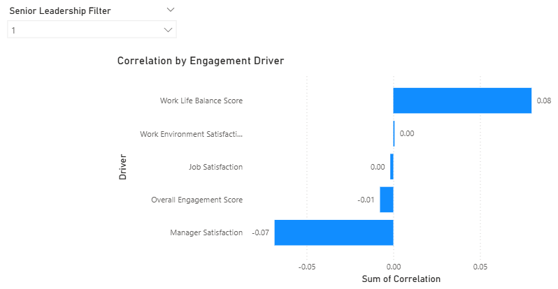
Engagement measures are too weak to explain leadership attrition
8/10
ANALYST INTERPRETATION
The correlation chart shows that engagement measures have very weak relationships with recent leadership exits. Work-life balance has only a small positive correlation of 0.08, manager satisfaction is mildly negative at -0.07, and the remaining engagement metrics sit at or near zero. In practical terms, none of these measures meaningfully predicts who is leaving. This supports the broader analytical conclusion from the earlier assignment: traditional engagement indicators did not show statistically significant relationships with leadership attrition. The business importance is high because it changes where management should look next. If leaders are not exiting primarily due to low engagement scores, then the organization needs to test other explanations, especially career mobility, promotion pathways, external market pull, and qualitative themes from exit interviews. That is where the next round of insight generation should be focused.
Source visuals: Power BI screenshots

Slide 9
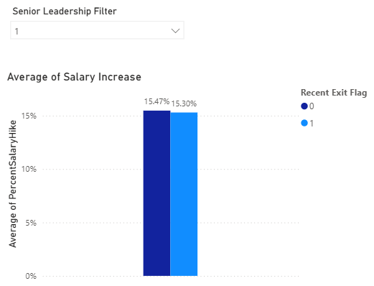
Salary increases did not materially differentiate leaders who left
9/10
ANALYST INTERPRETATION
Salary increase percentages are almost identical across the two groups, at roughly 15.47 percent and 15.30 percent. That tells us recent exits were not concentrated among leaders who received meaningfully lower pay increases. In other words, standard annual salary actions did not materially differentiate leaders who stayed from leaders who left. This matters because compensation is often assumed to be the default lever for retention. The visual suggests that across this leadership group, regular merit increases alone were not enough to explain turnover. For Pulse Diagnostics, this means simply increasing salary budgets broadly may not address the problem efficiently. A better response is to examine whether high-value leaders are seeing credible advancement opportunities, differentiated rewards, and clear career pathways. The organization may be facing a mobility and opportunity challenge more than a standard pay-increase challenge.
Source visuals: Power BI screenshots

Slide 10
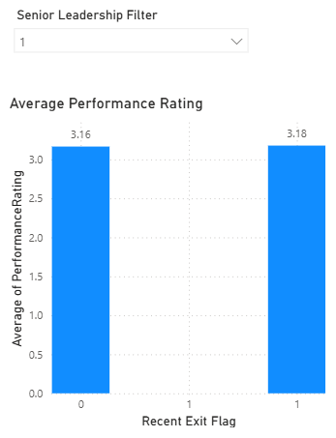
Performance ratings were virtually the same for leavers and non-leavers
10/10
ANALYST INTERPRETATION
Average performance ratings are also nearly identical at 3.16 versus 3.18, showing that recent exits were not isolated among weaker performers. If anything, the organization appears to be losing leaders whose performance profile looks very similar to those who remained. That is strategically important because it suggests attrition is not functioning as a performance filter; it may instead represent the loss of capable and productive leadership talent. Combined with the salary and engagement visuals, this chart strengthens the overall conclusion that leadership exits are being driven by factors beyond the core HR variables available in the current dataset. For the organization, the next step should be to separate voluntary and involuntary exits, analyze promotion and mobility patterns, and incorporate exit-interview or labor-market evidence to uncover the real drivers of leadership loss.
Source visuals: Power BI screenshots

